Slide 1
MOTORCYCLE SAFETY SYSTEM

Slide 2
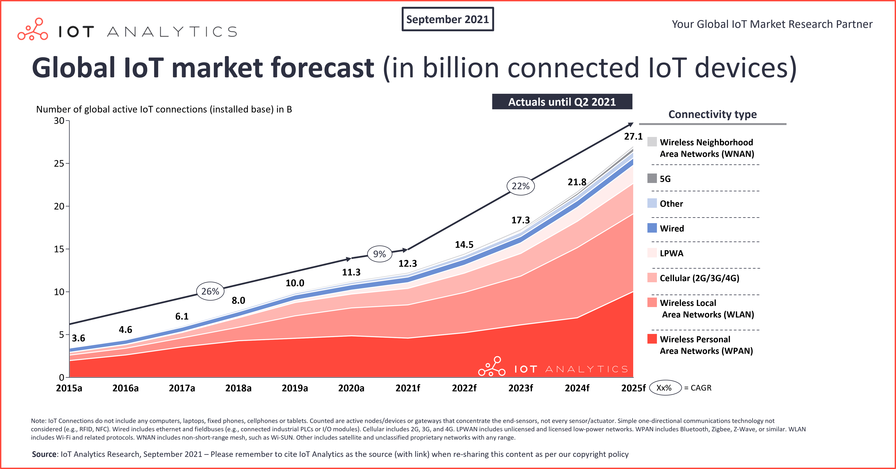

Slide 3
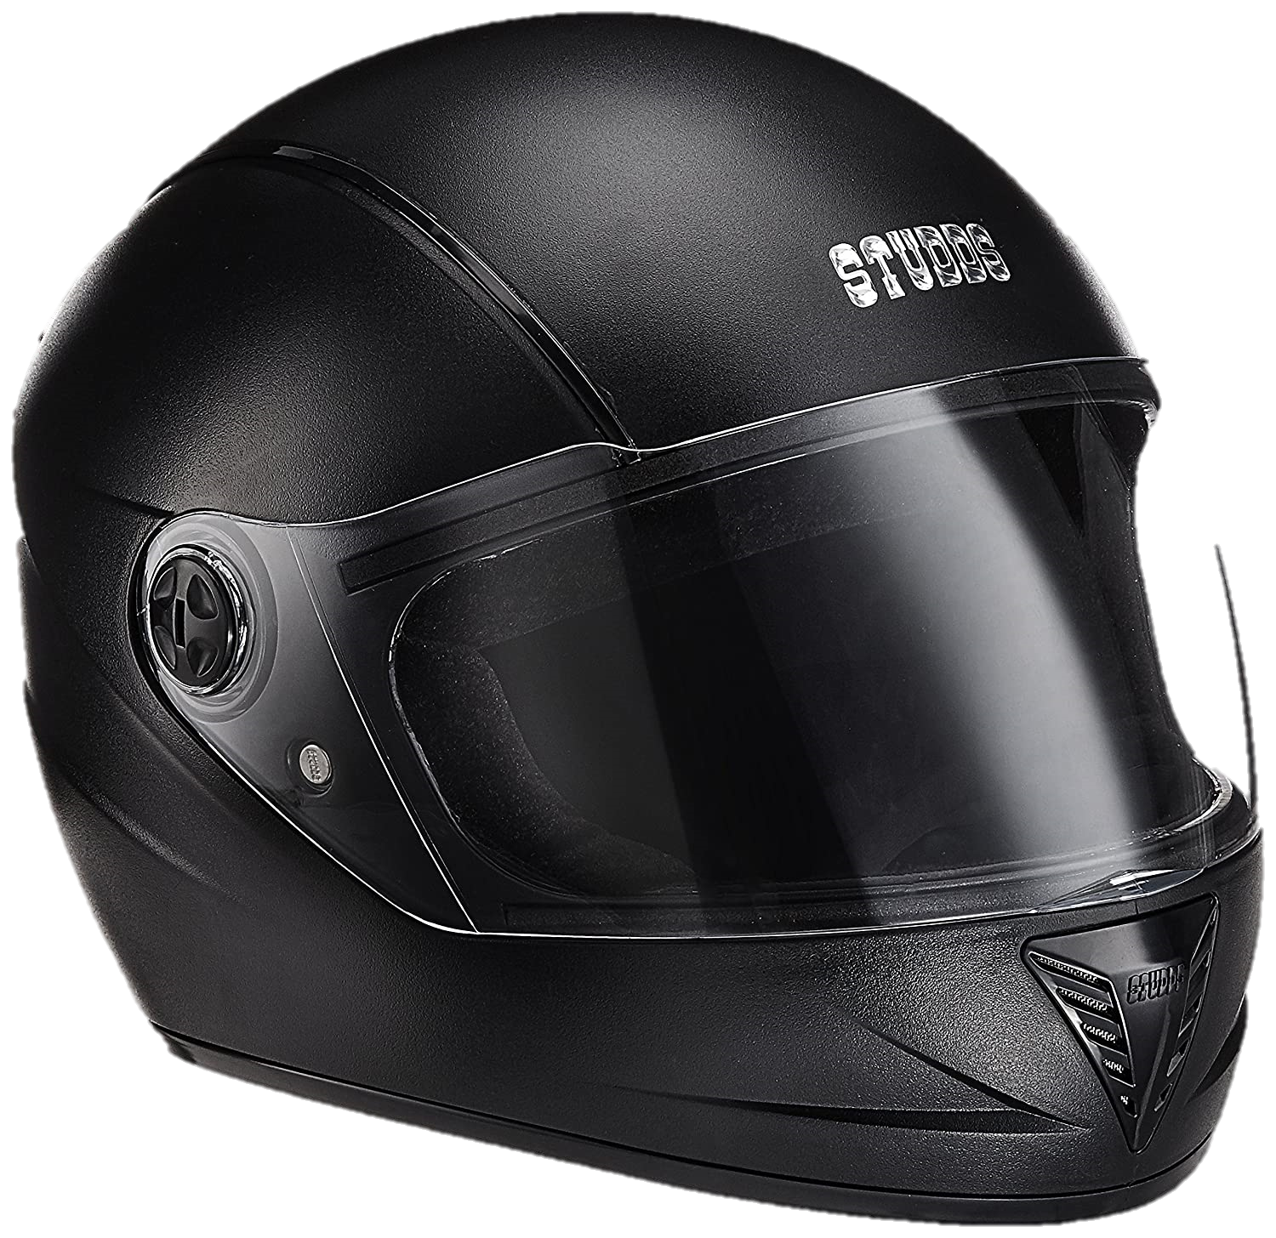
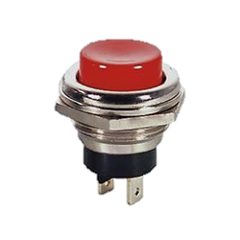


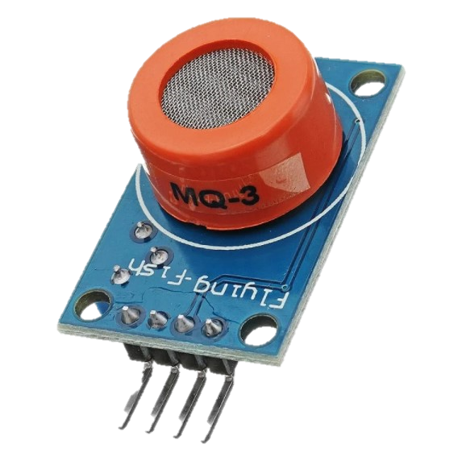
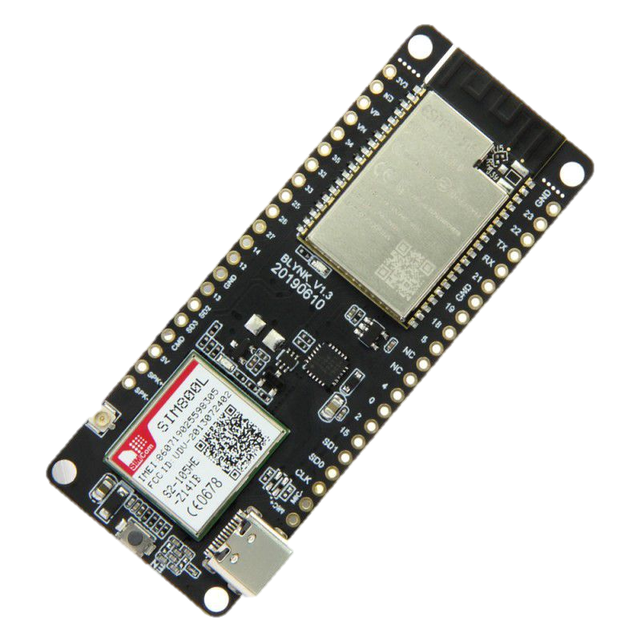
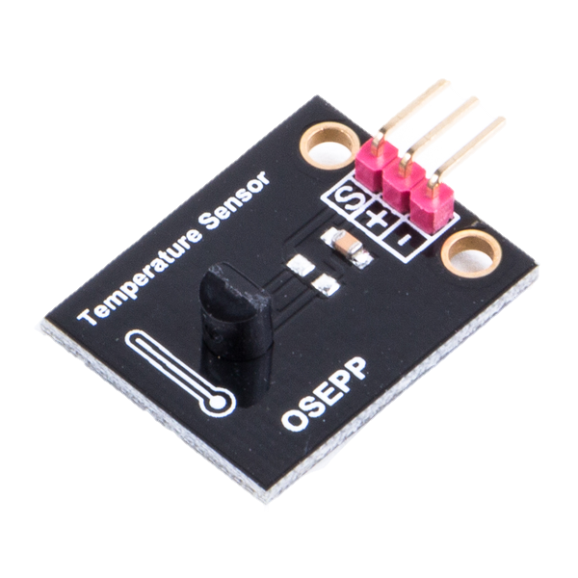
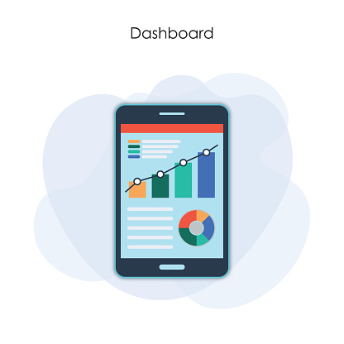
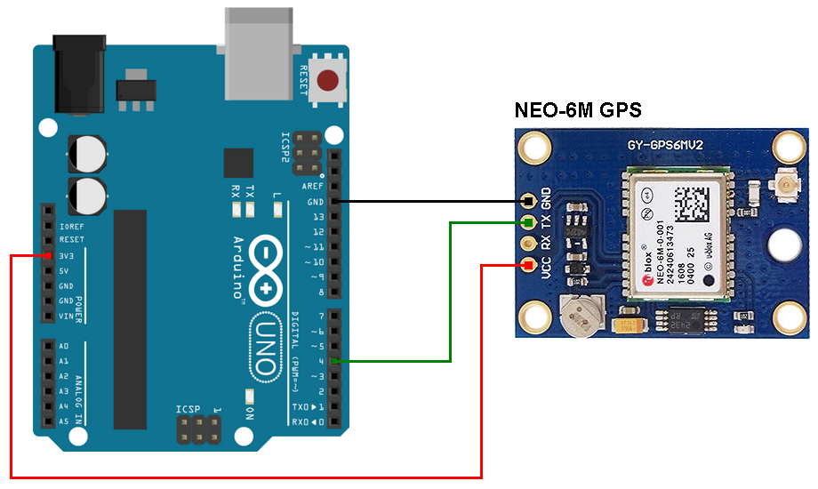

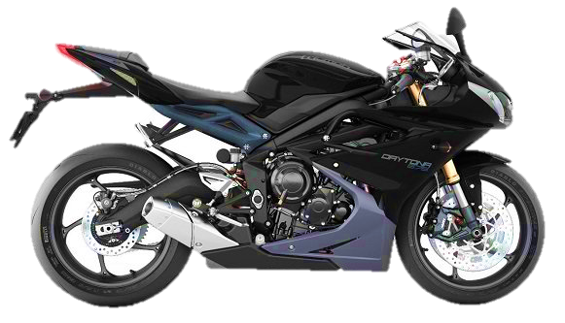
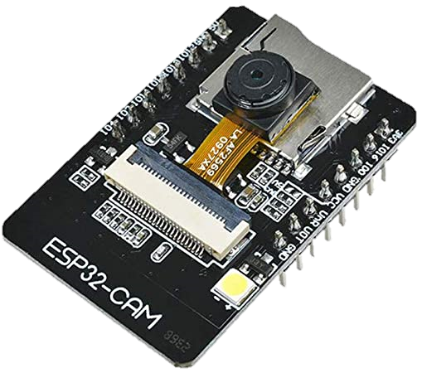
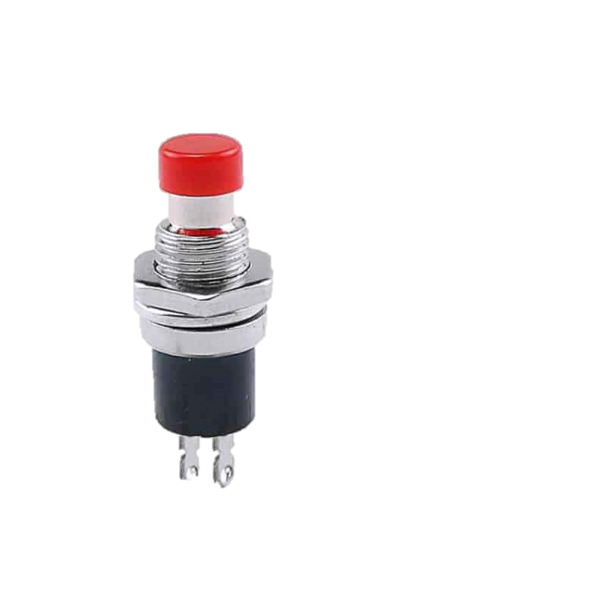

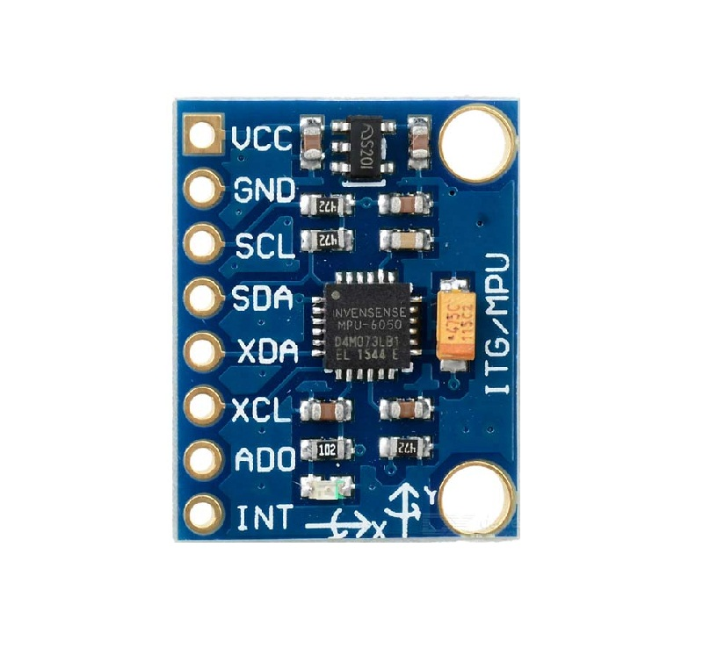
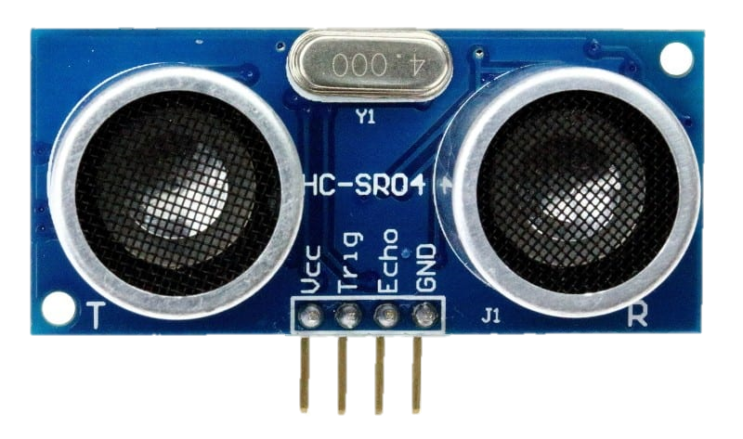
Helmet with MQ3 sensor
Send data to cloud platform, ThingsBoard
Push Button
MQ3 Sensor
Motorcycle equipped with multiple sensors and camera
App Access Sensor Data
LM35
Neo 6M GPS
ESP32 SIM800L Module
ESP32-CAM
Termination
button
Send message automatically to authorized contact when detect accident
MPU6050
HC - SR04

Slide 4
System States
Ignition State / Operational State
Parking State / Non-Operational State
Components that are active in this state:
Components that are active in this state:
MQ3
Ultrasonic Sensor ,HC- SR04
LM35
ESP32 Cam
MPU6050
Neo 6M GPS Module
Ultrasonic Sensor ,HC- SR04
ESP32 Cam
Neo 6M GPS Module

Slide 5
Start
Connect to the GSM/GPRS module (ESP32 SIM800L)
Terminate
ESP32 Cam checks for authorized user
yes
Check for helmet and alcohol presence
Send GPS location to emergency contact via SMS
no
yes
no
Helmet?
Accident?
[Abort sending message]
Send an alert message to pre- specified number
yes
yes
yes
Alcohol ?
> threshold value?
no
Provide permission to start the motorcycle
System continuously monitors alcohol level, engine temperature, speed, lean angle, distance with other vehicle and location as well as sends data to cloud
no

Slide 6
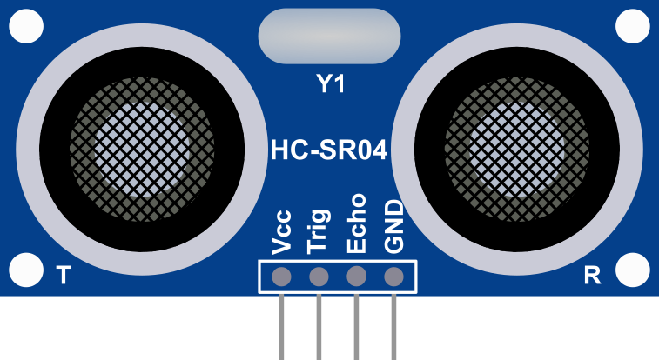
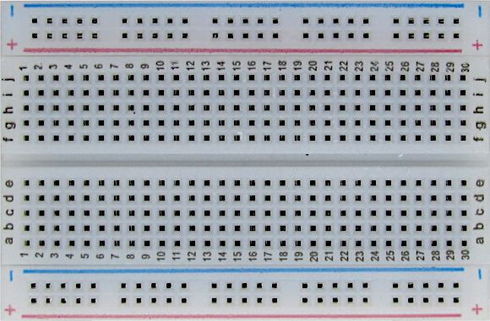
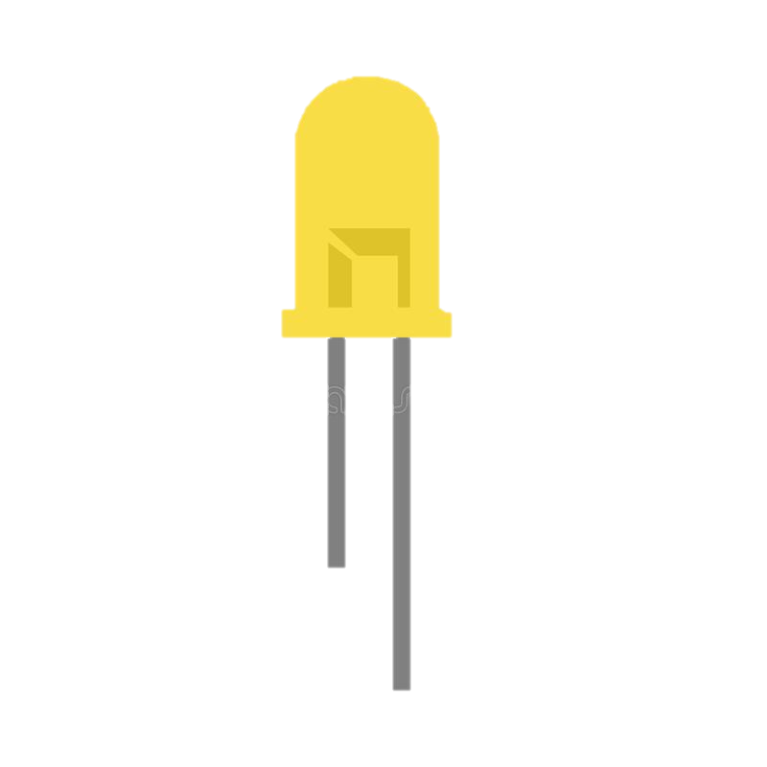
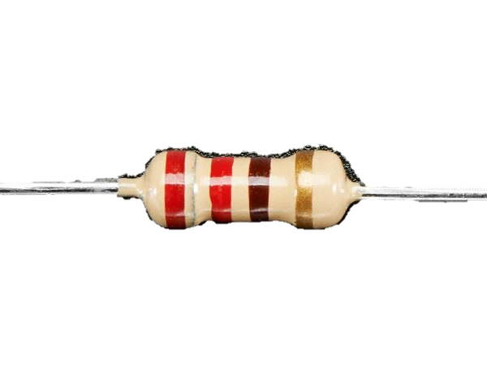
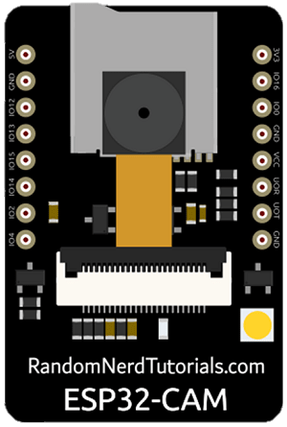
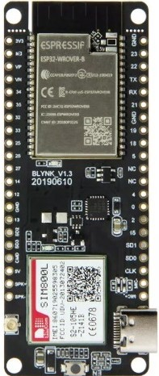
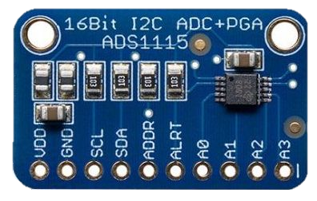
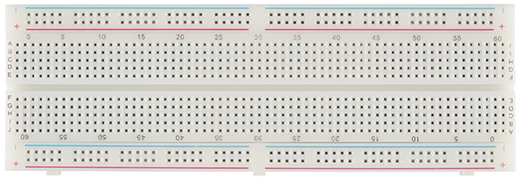
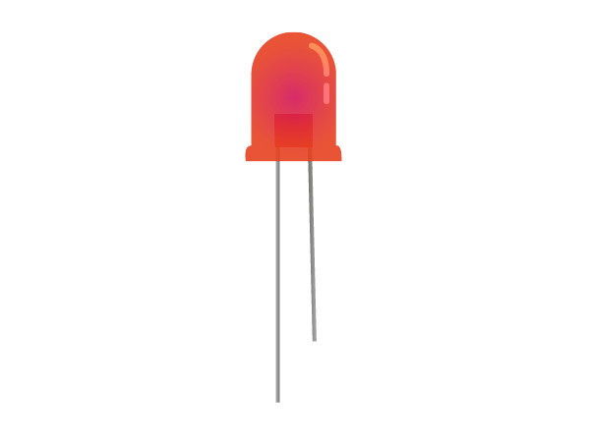
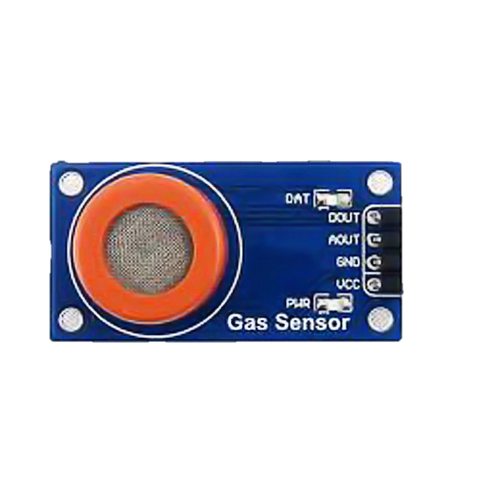
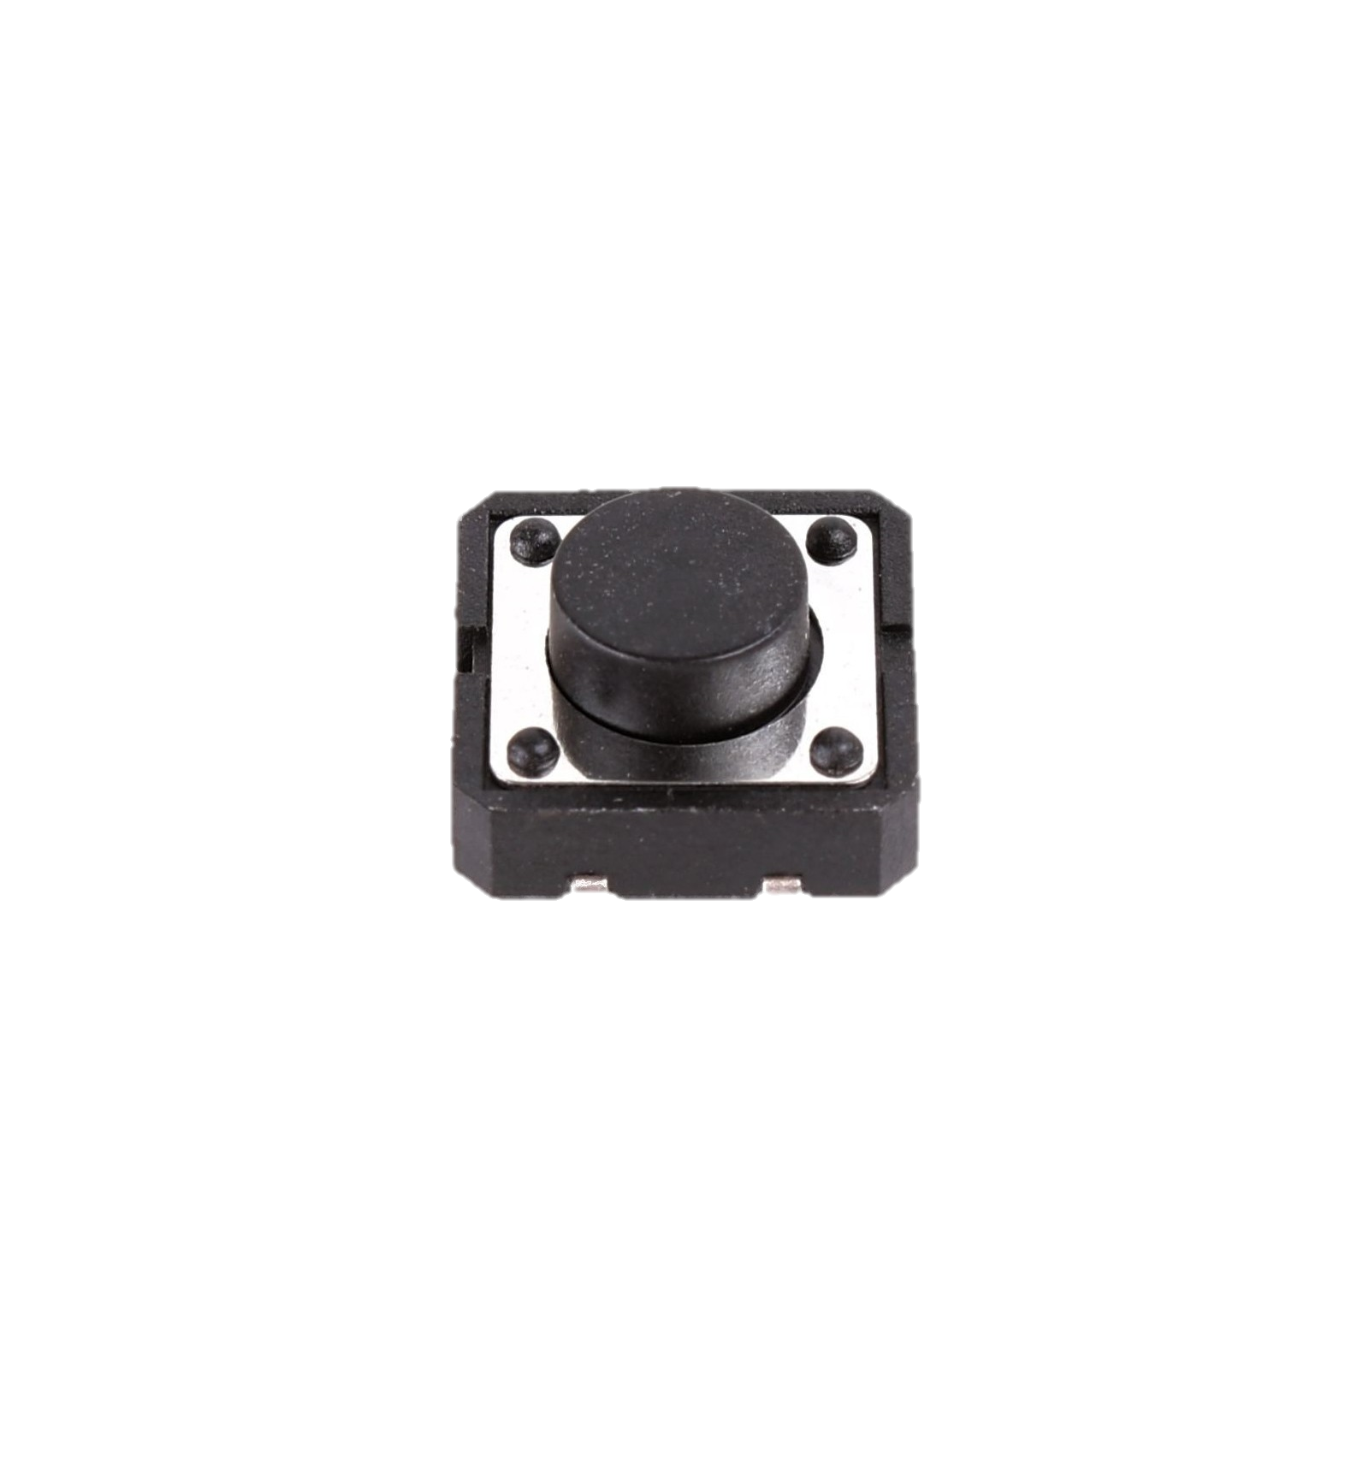
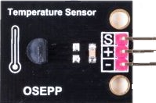
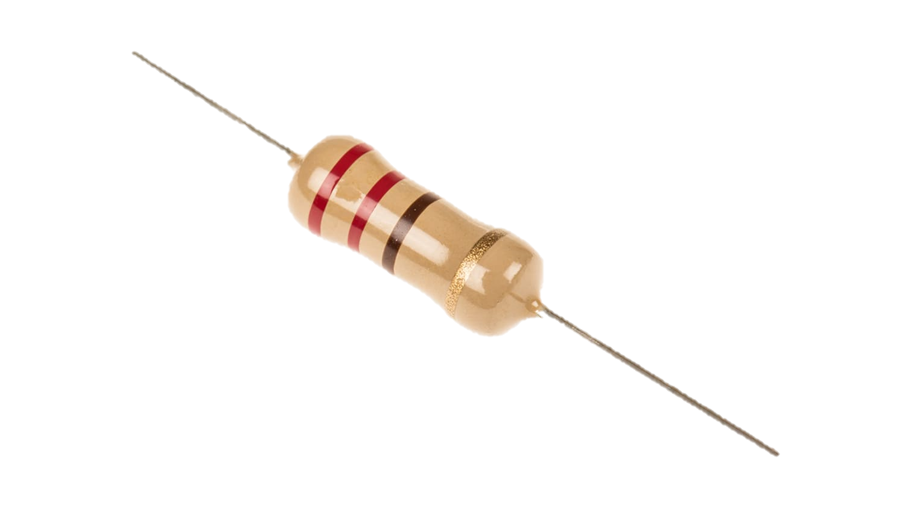
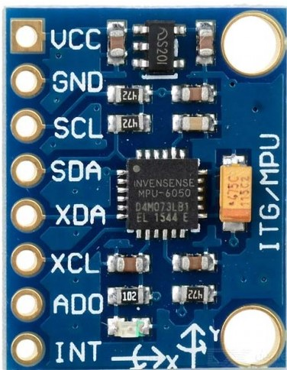
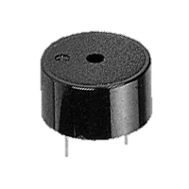

Slide 7
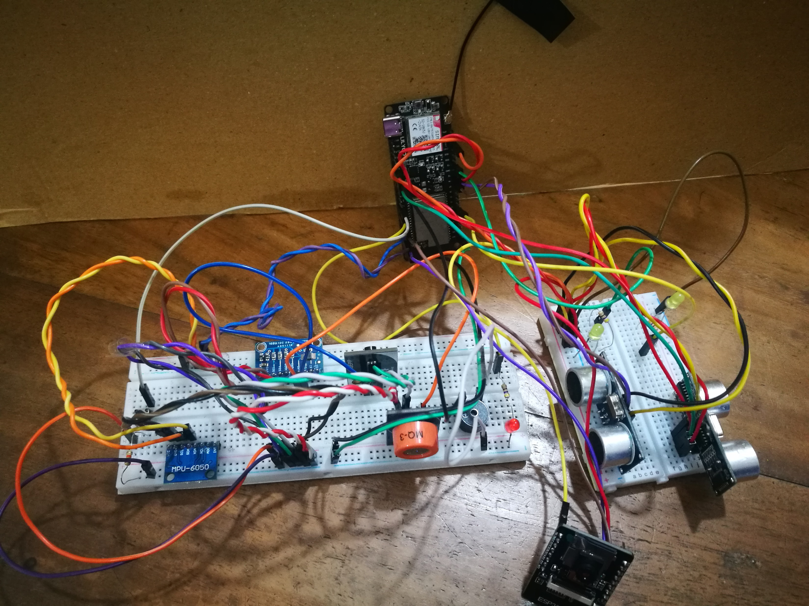

Slide 8
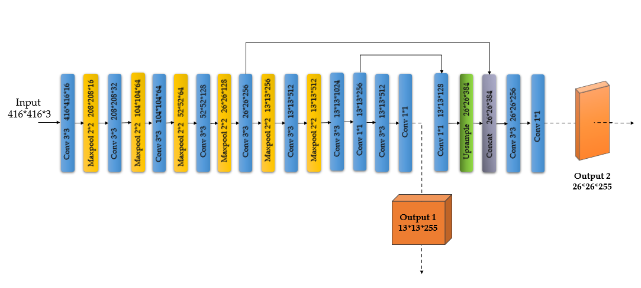
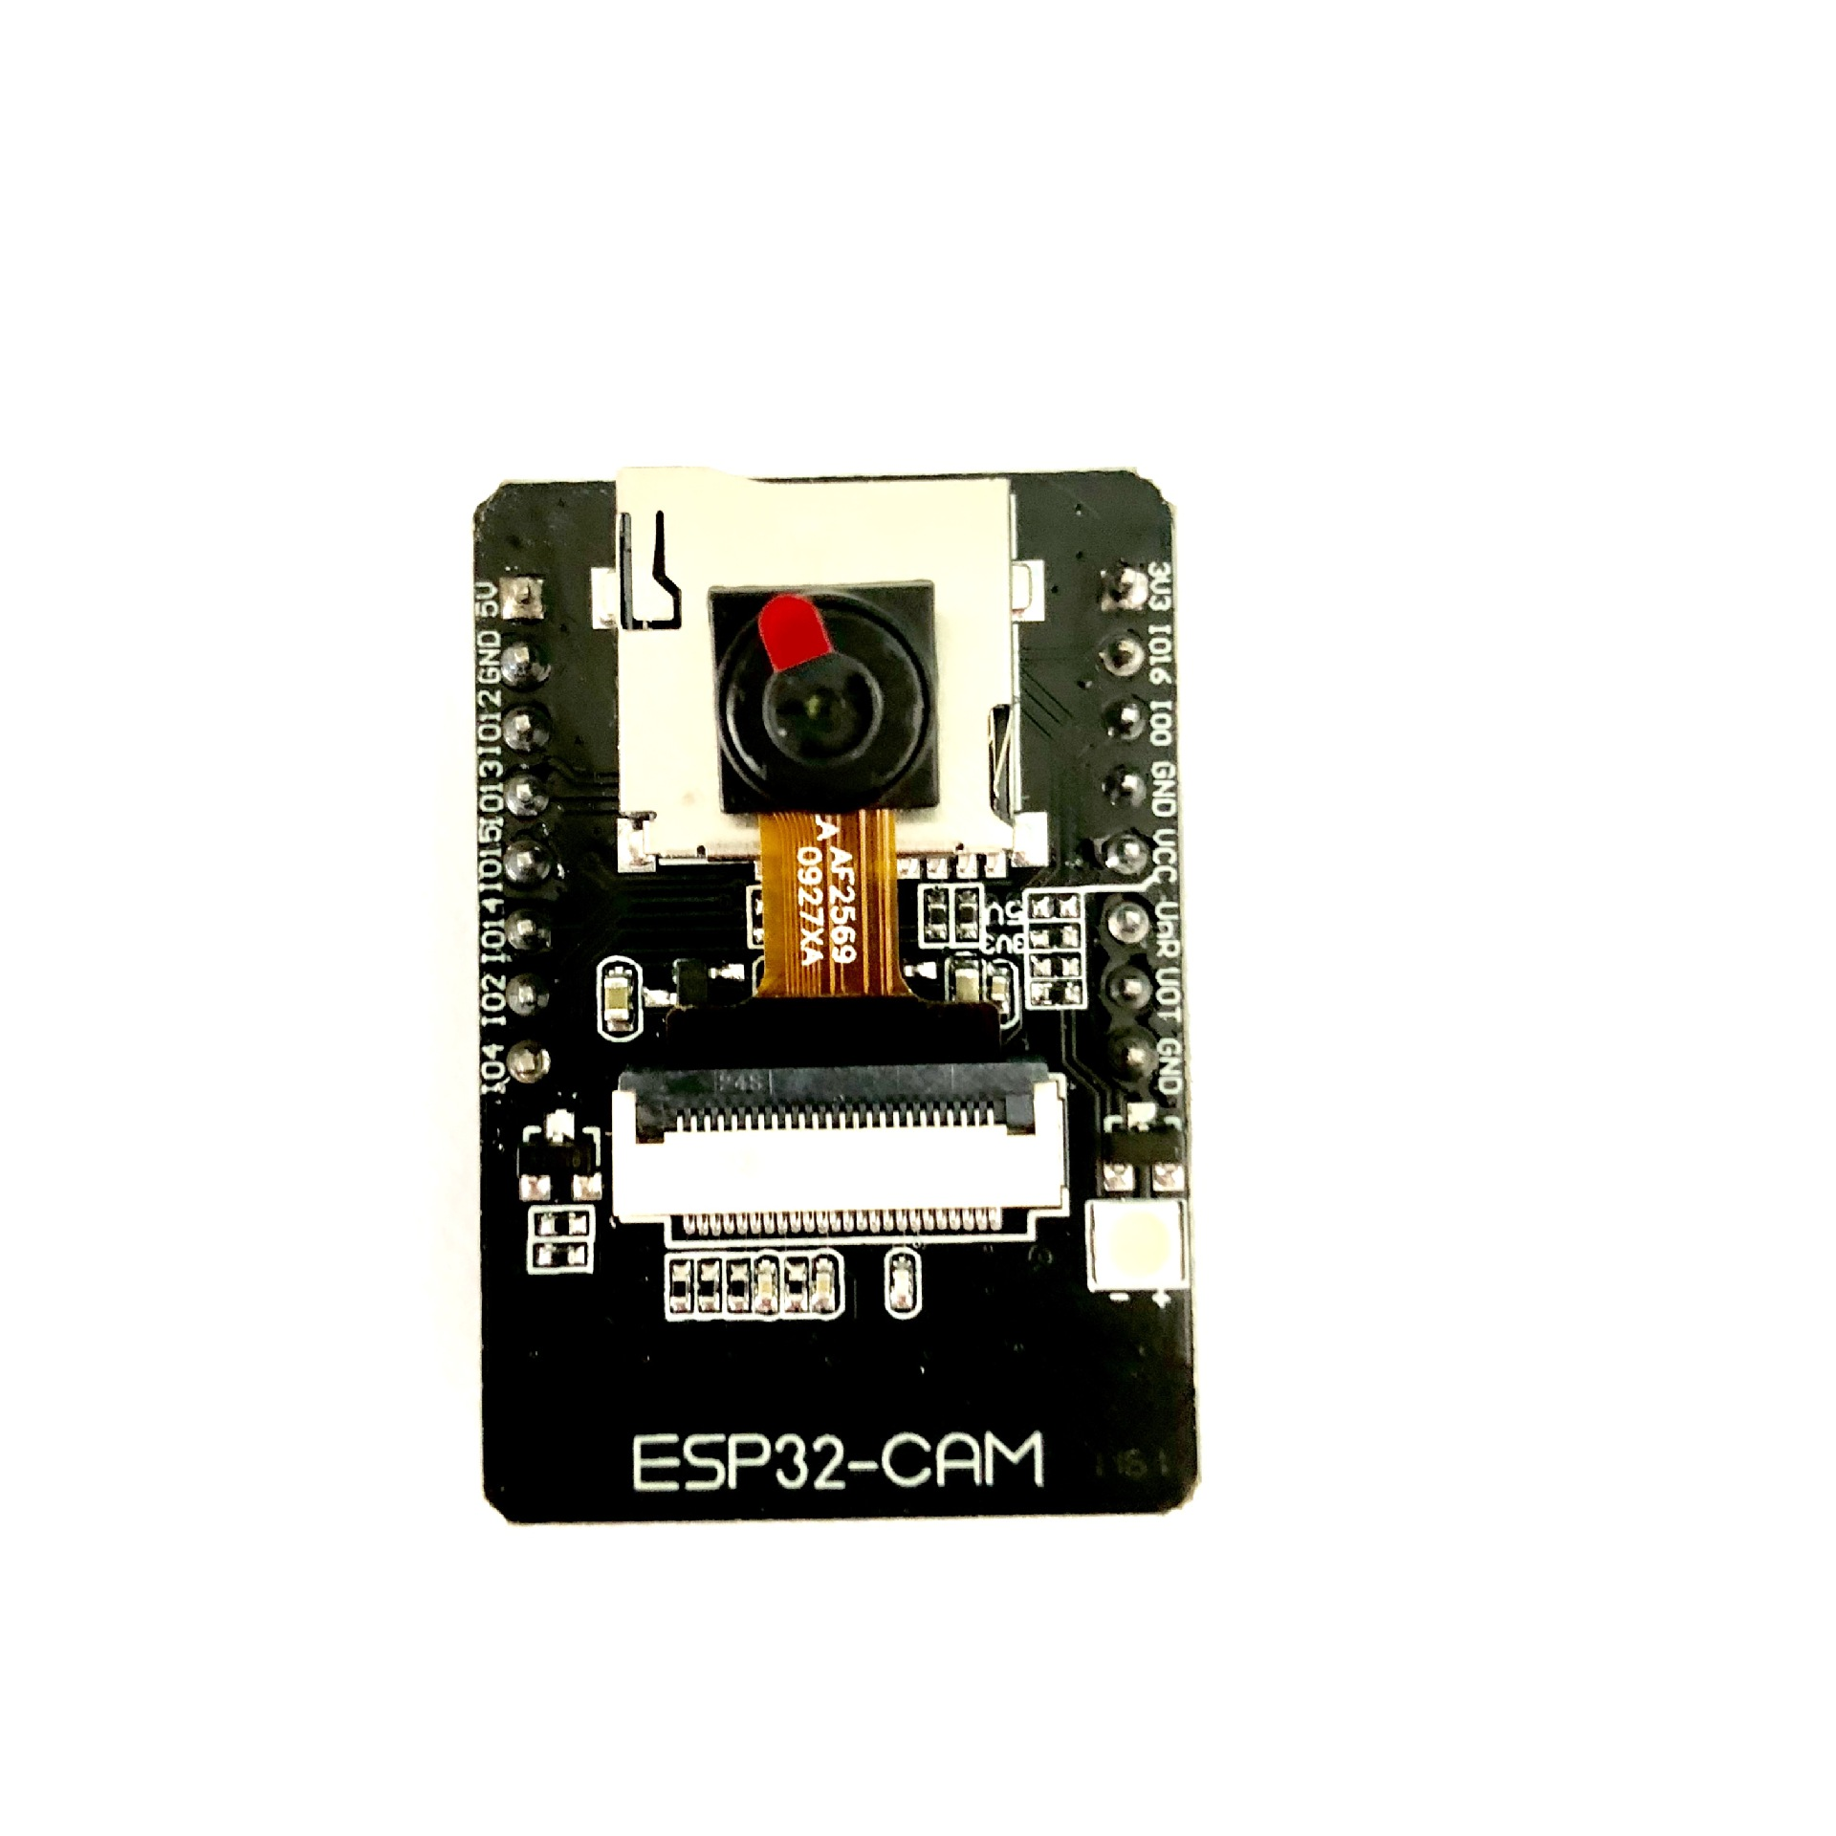
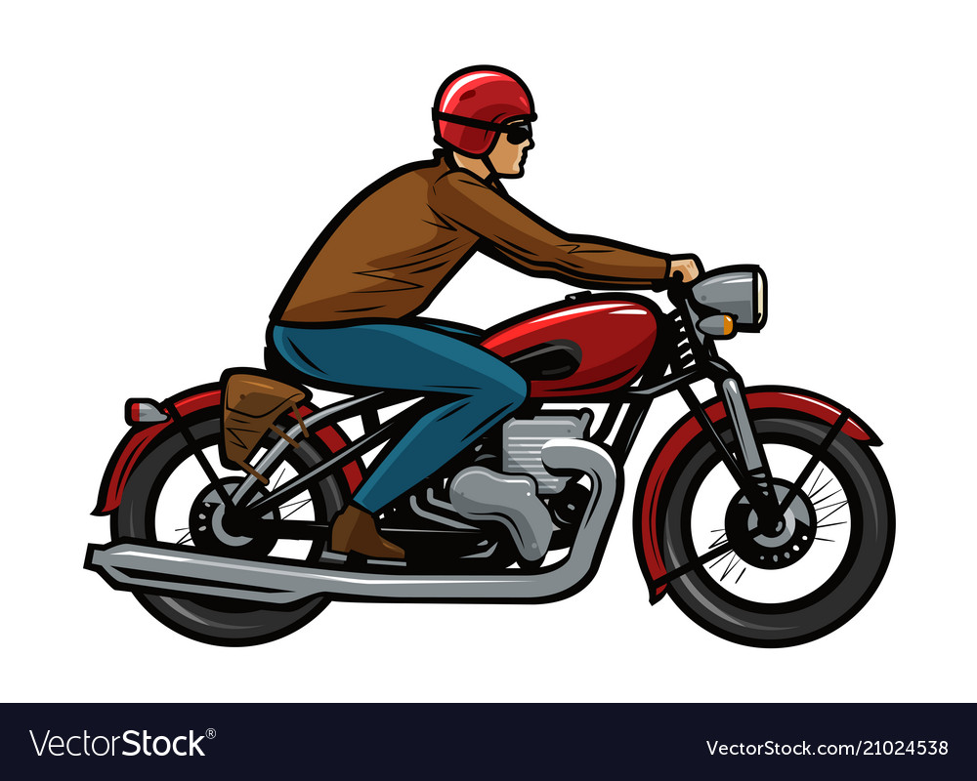

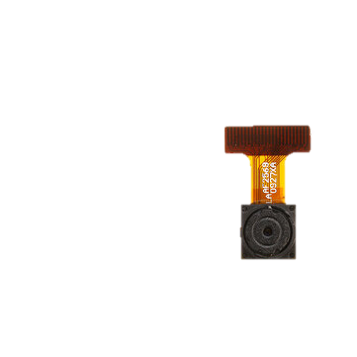


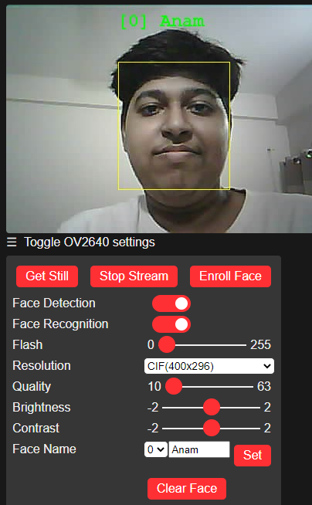
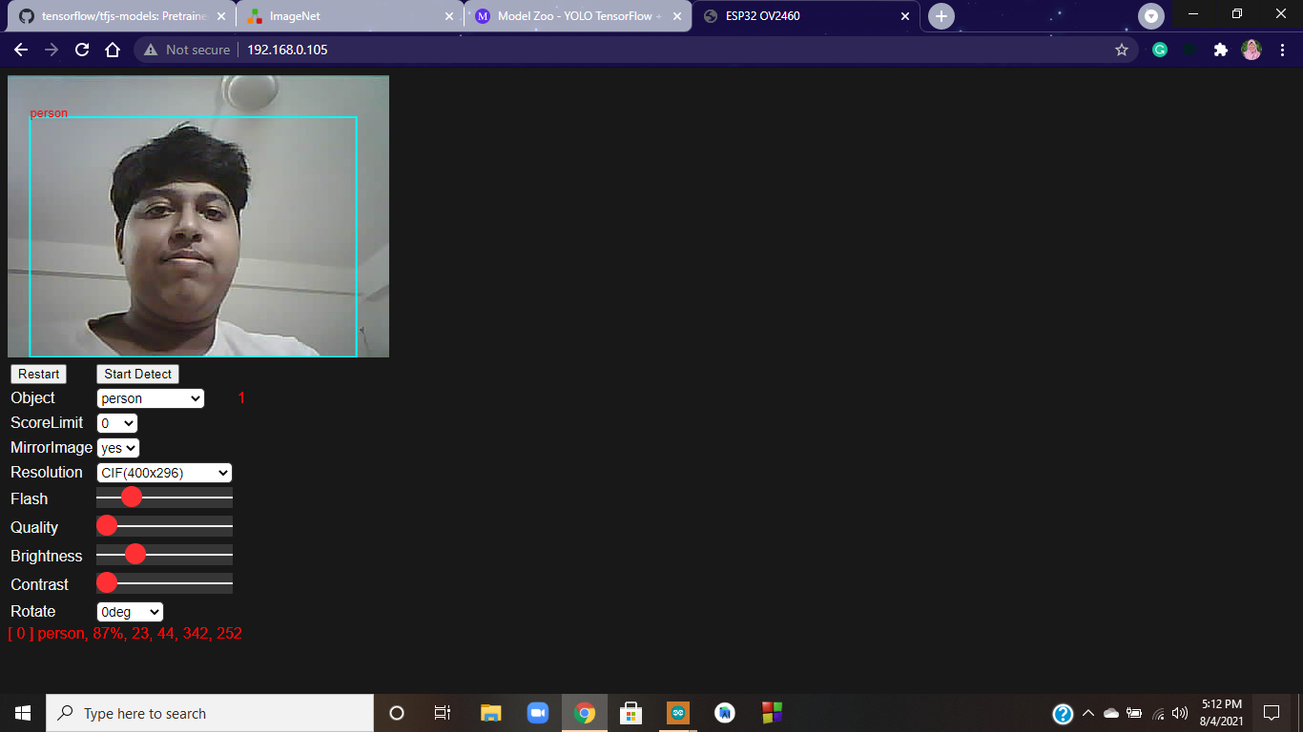
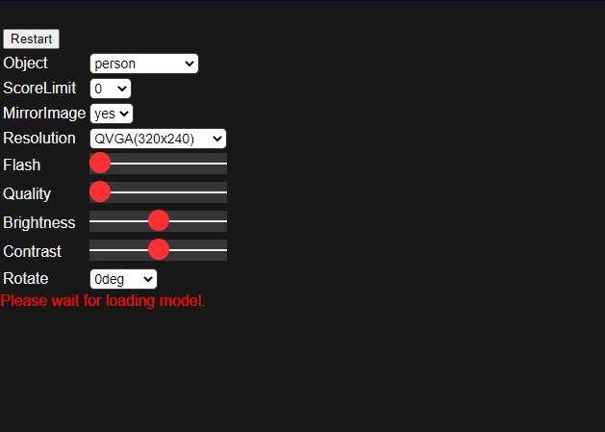
YOLO Tiny V3
Face Recognition
Person Detection
Load the model into the browser

Slide 10
Start
ESP32 Cam triggered, capture the front view and send it to the pre-specified mail address
Connect to the GSM/GPRS module (ESP32 SIM800L)
Neo 6M GPS module activate
Continuously monitors nearby distance via ultrasonic sensor
ESP32 CAM scan for intruder face
Distance with nearby object < threshold ?
Continue the alert state?
yes
yes
no
no
Terminate

Slide 11
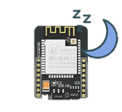
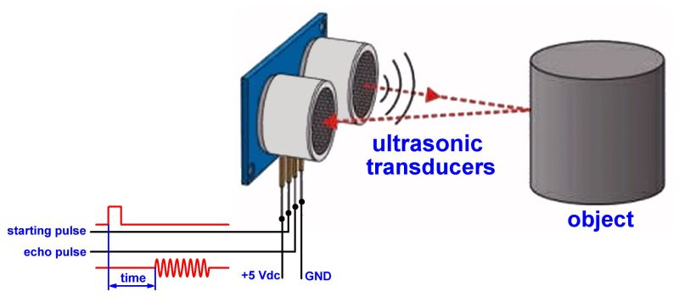
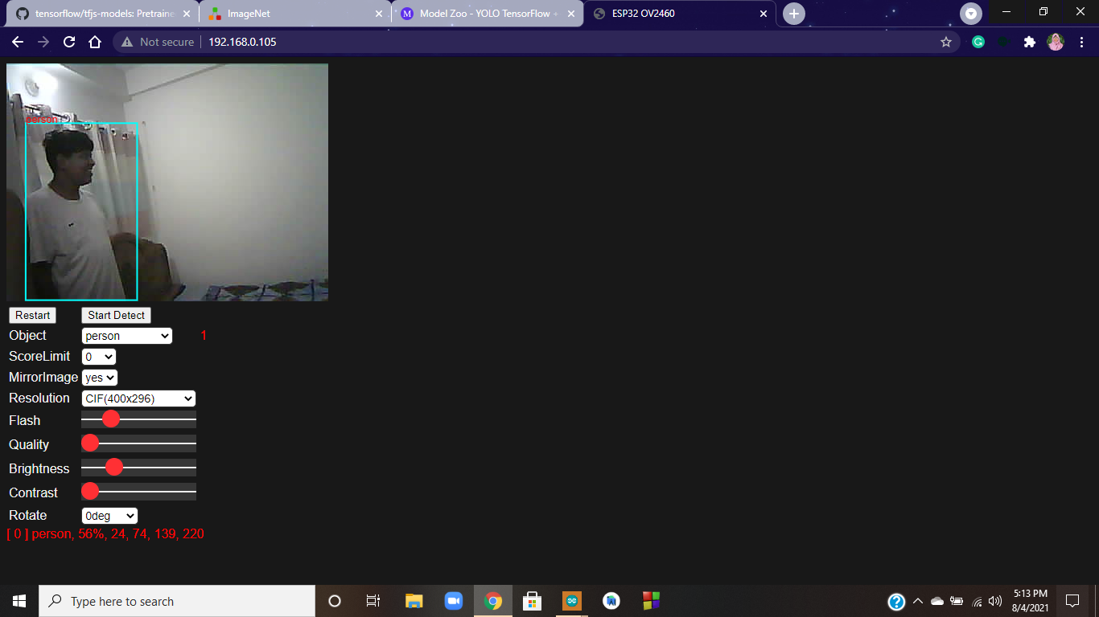
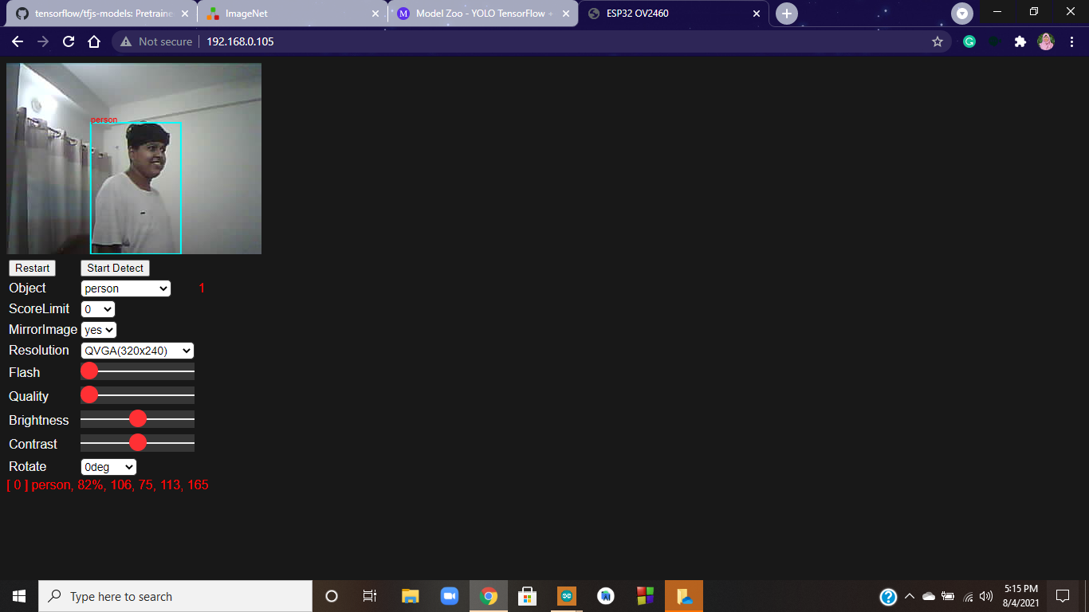

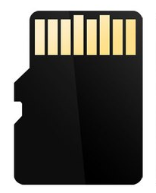
Deep Sleep
Nearby Object Detected
Person Detected
Capture Image
Mail the Image
Save Image to SD Card

Slide 12
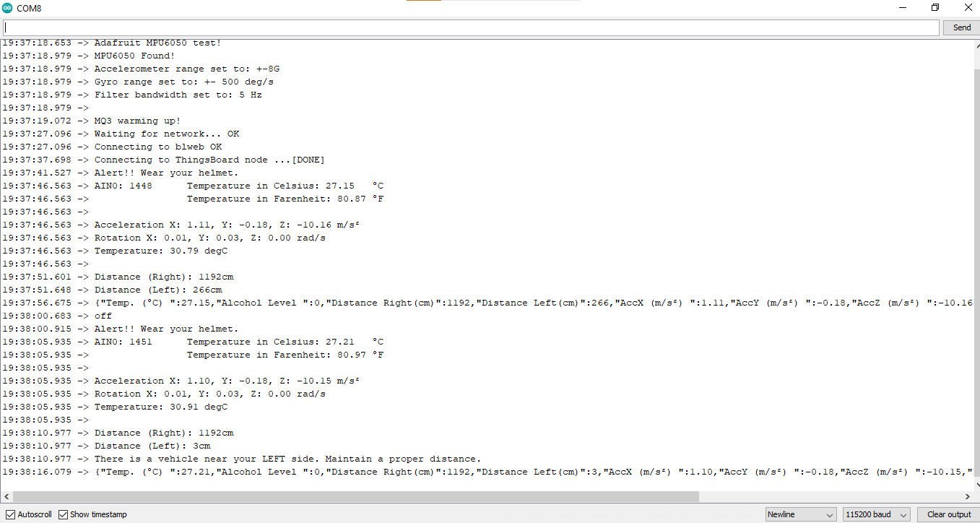

Slide 13
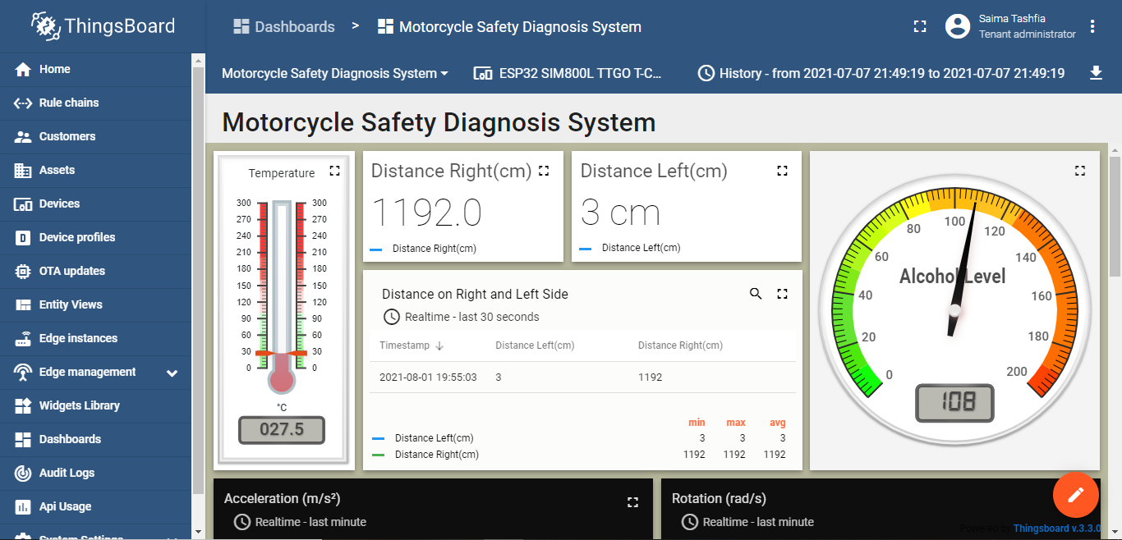
ThingsBoard Dashboard

Slide 14
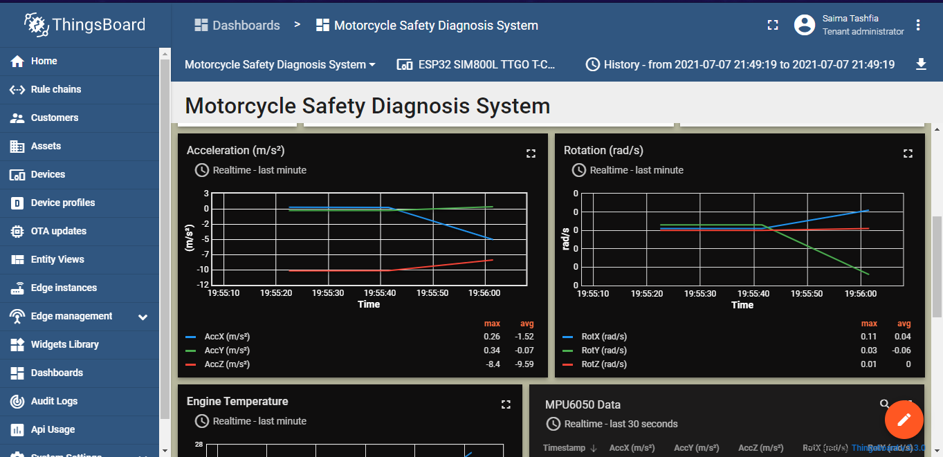

Slide 15
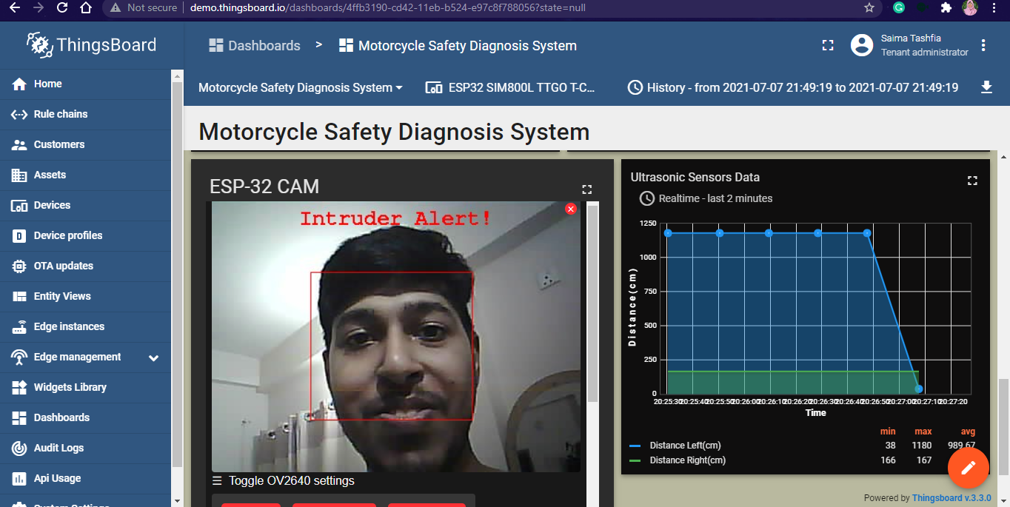

Slide 16
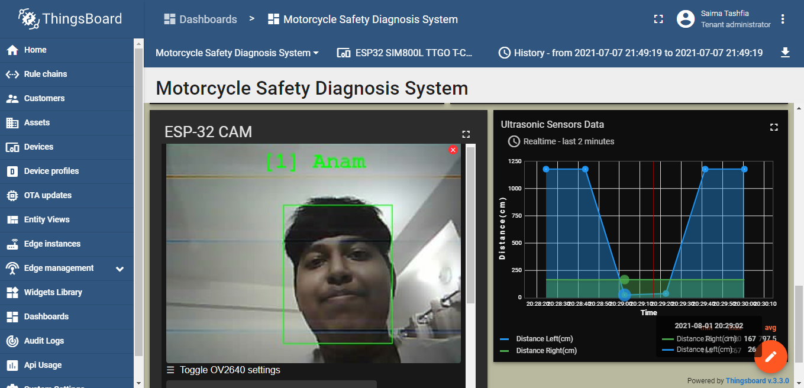

Slide 17
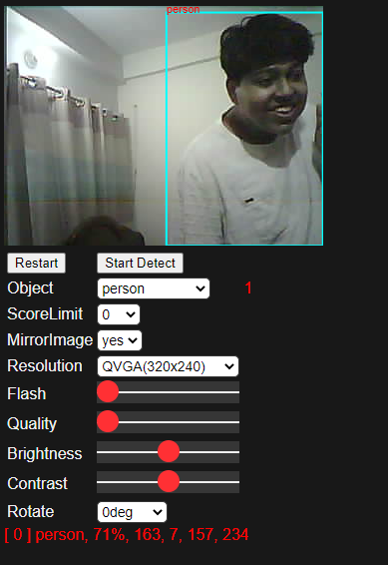

Slide 18
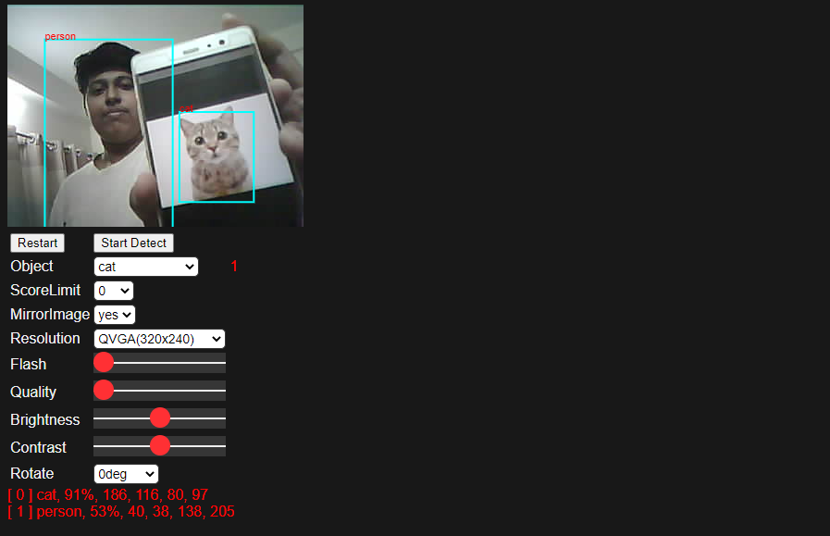

Slide 19
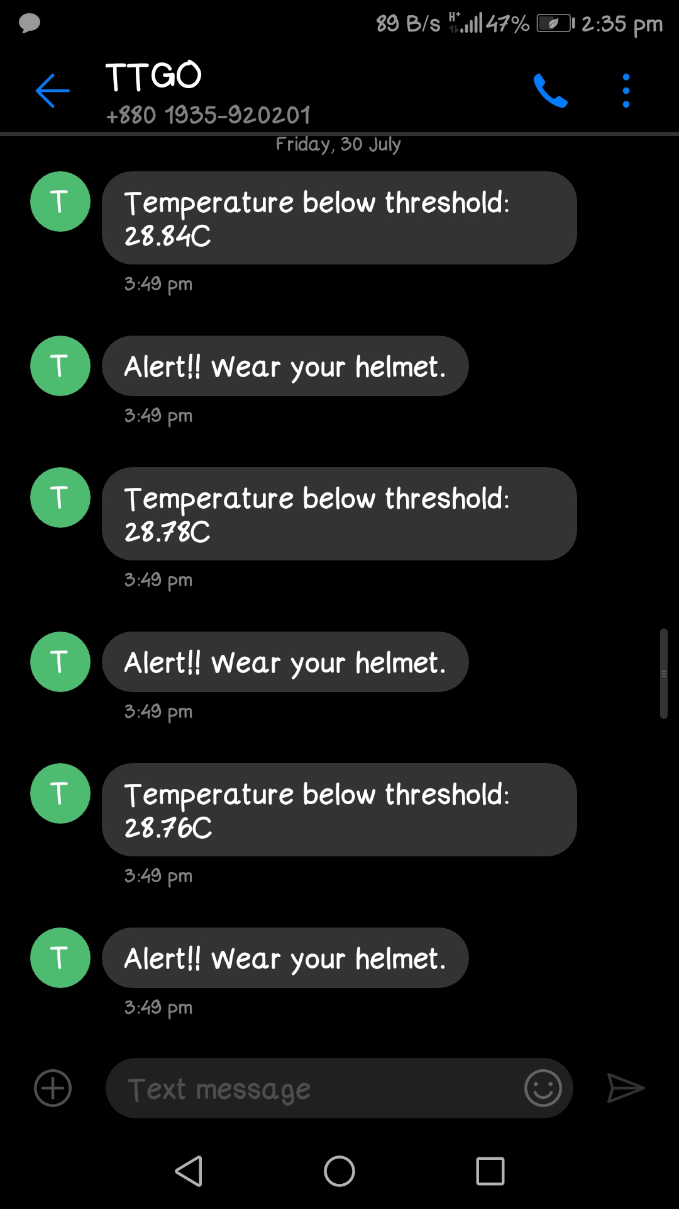
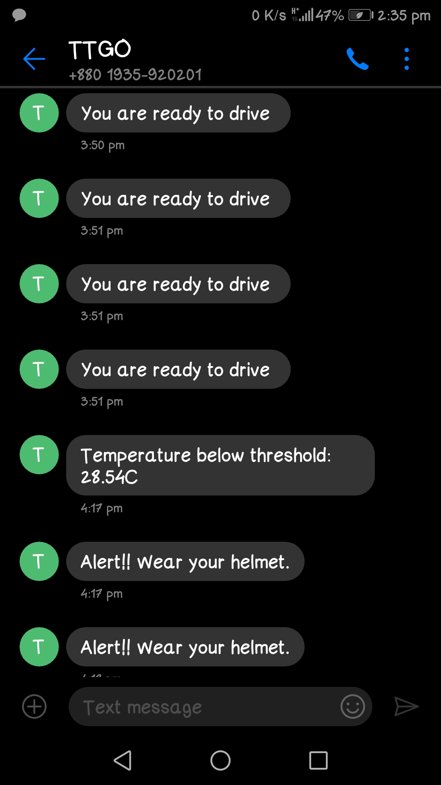

Alert Messages

Slide 20

Lateral acceleration
Acceleration due to
gravity, g
Total acceleration

Slide 21


Slide 22


z-axis
-
Yaw
+
Pitch
-
+
Roll
y-axis
-
x-axis
+

Slide 23


Slide 24




Slide 25


Slide 26
Push Button
X 2
Servo Motor
X 3
Buzzer
Neo 6M GPS
Module
MQ3 Sensor
ADS1115 16-Bit
ESP32 SIM800L
MPU6050
LM35
HC-SR04
Ultrasonic Sensor
X 3
ESP32 CAM
Power Supply
LED Indicators
X 3

Slide 27


Slide 28


Slide 29


Slide 30








Object
distance 125 cm
> 90cm
distance 40 cm
< 90cm

Slide 31









Accident happened
GPS module traces
the location
Alert message is sent to the emergency contact by ESP32 SIM800L
Emergency contact receive
the message and location
Patient is being shifted to hospital
Ambulance for medical assistance
Emergency services
receive the call

Slide 32

Conv 1*1
Conv 1*1 13*13*128
Concat 26*26*384
Conv 1*1 13*13*256
Upsample 26*26*384
Conv 3*3 26*26*256
Conv 3*3 416*416*16
Maxpool 2*2 104*104*32
Conv 3*3 13*13*1024
Maxpool 2*2 208*208*16
Maxpool 2*2 13*13*256
Conv 3*3 104*104*64
Conv 3*3 26*26*256
Maxpool 2*2 13*13*512
Conv 1*1
Conv 3*3 208*208*32
Maxpool 2*2 52*52*64
Conv 3*3 13*13*512
Conv 3*3 52*52*128
Maxpool 2*2 26*26*128
Conv 3*3 13*13*512
Input
416*416*3
Output 2
26*26*255
Output 1
13*13*255

Slide 33


Slide 34





Smartphone
Subscribe to MQTT Topic
Publish MQTT Data
Subscriber
Publish MQTT Message
MQTT Topic: devices/id/data
Sensors Embedded
Vehicle
ThingsBoard
Subscribe to MQTT Topic
Publish MQTT Data
Publisher
MQTT Broker
PC/Laptop
Subscriber

Slide 35



Slide 36


Slide 37

Let's now define the most basic terms, which are whole numbers (not rates):
true positives (TP): These are cases in which we predicted yes (they have the disease), and they do have the disease.
true negatives (TN): We predicted no, and they don't have the disease.
false positives (FP): We predicted yes, but they don't actually have the disease. (Also known as a "Type I error.")
false negatives (FN): We predicted no, but they actually do have the disease. (Also known as a "Type II error.")

Slide 38

 | Positive | Negative
Positive | True Positive (TP) | False Negative (FN) | Recall $$\frac{TP}{TP+FN}$$
Negative | False Positive (FP) | True Negative (TN)
 | Precision $$\frac{TP}{(TP+FP)}$$ |  | Accuracy $$\frac{TP+TN}{(TP+TN+FP+FN)}$$

Slide 39


Slide 40


Slide 41


Slide 42




Internet of
Things

Slide 43









Smart Homes and Cities
Transportation
IoT significantly improves the way we control and monitor all the processes taking place at our home. IoT devices such as linked sensors, lighting, and meters are used in smart cities to gather and analyze data which are then used by cities to enhance infrastructure, public utilities, and services, among other things.
IoT is projected to disrupt transportation by lowering delays, forecasting inbound material shortages, and modifying orders in the middle of manufacturing based on real-time demand data.
Wearables
Smart Retail
Fitbits, iPhones, Apple watches, and health monitors, to mention a few, are examples of wearables. These devices increase entertainment, network connectivity, health, and fitness.
IOT
IoT sensors can leverage data from online and in-store sales to drive warehouse automation and robotics. RFIDs, which are already widely used around the world, are used for this.
Smart Agriculture
Healthcare
IoT-enabled devices can detect soil moisture and nutrients, as well as weather data, to improve the control of smart irrigation and fertilizer systems.
IoT enabled devices have made remote monitoring in the healthcare sector possible, unleashing the potential to keep patients safe and healthy, and empowering physicians to deliver superlative care.
Notes:
© Copyright PresentationGO.com – The free PowerPoint and Google Slides template library

Slide 44


Slide 45
YEAR-WISE ROAD CRASHES AND DEATH
YEAR | ACCIDENTS | DEATH
2020 | 4891 | 6686
2019 | 5516 | 7855
2018 | 5514 | 7221
2017 | 4979 | 7397
2016 | 4317 | 6055

Slide 46
YEAR-WISE ROAD CRASHES AND DEATH
YEAR | ACCIDENTS | DEATH
2020 | 4891 | 6686
2019 | 5516 | 7855
2018 | 5514 | 7221
2017 | 4979 | 7397
2016 | 4317 | 6055

Slide 47



Slide 48


Slide 49


















Application Layer
Applications
Data Processing Layer
Processing Unit
Network Layer
Gateways
Sensing Layer
Sensors

Slide 50


Slide 51


Slide 52


Slide 53
User Fetches
Outputs
Relu
TensorFlow
Flows Tensors
Add
TensorFlow Performs
Operations
b
MatMul
TensorFlow
Trains
Variables
w
x
User Feeds
Inputs

Slide 54


Slide 55
Service | Availability
Vital Registration System | Yes
Emergency Room Based Injury Surveillance System | No
Emergency Access Telephone Numbers | Yes
Seriously Injured Transported by Ambulance | ≤ 10%
Permanently disabled due to Road traffic Crash | 220 people everyday

Slide 56


Slide 57
Manuscripts identified through google scholar searching
(n = 127 )
Additional manuscripts identified through other sources
(n= 19)
Identification
Manuscripts excluded on the basis of titles, abstract and journal because they did not focus on accident detection or prediction
(n= 45 )
Manuscripts after duplicates removed
(n= 114)
Screening
Full-text manuscripts excluded because of unclear explanation, not focus on vehicle safety and security
(n= 16)
Full-text articles assessed for eligibility
( n= 69)
Eligibility
Studies included for literature review
( n= 52 )
Included

Slide 58


Slide 59


Slide 60


Slide 61


Slide 62


Slide 63


Slide 64


Slide 65
YOLO was created to help improve the speed of slower two-stage object detectors, such as Faster R-CNN.
While R-CNNs are accurate they are quite slow, even when running on a GPU.
On the contrary, single-stage detectors such as YOLO are quite fast, obtaining super real-time performance on a GPU.
The downside, of course, is that YOLO tends to be less accurate (and in my experience, much harder to train than SSDs or RetinaNet).
Since Tiny-YOLO is a smaller version than its big brothers, this also means that Tiny-YOLO is unfortunately even less accurate.
For reference, Redmon et al. report ~51-57% mAP for YOLO on the COCO benchmark dataset while Tiny-YOLO is only 23.7% mAP — less than half of the accuracy of its bigger brothers.
That said, 23% mAP is still reasonable enough for some applications.
My general advice when using YOLO is to “simply give it a try”:
In some cases, it may work perfectly fine for your project.
And in others, you may seek more accurate detectors (Faster R-CNN, SSDs, RetinaNet, etc.).
https://www.pyimagesearch.com/2020/01/27/yolo-and-tiny-yolo-object-detection-on-the-raspberry-pi-and-movidius-ncs/

Slide 66






Slide 67



Slide 68



Slide 69



Slide 70




